Slide 1
#06 Methods, parameters, scope and properties
Notes:
Give an explanation for the concepts method, parameter scope and property
Relevant theoretical decisions
What is a method, when and how is it used?
What kind of methods is common in C# programs?
What is the difference between arguments and parameters?
What is the difference between value and reference parameters?
What is meant by the word scope?
What are properties, how and why are they used or useful?

Slide 2
Class

Slide 3
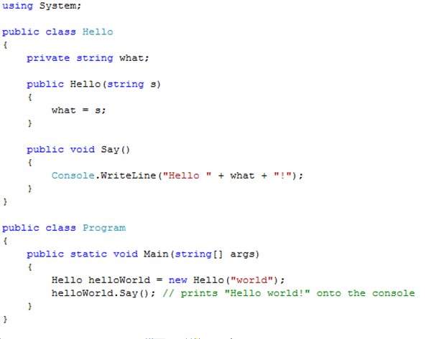
Class Example and Visibility

Slide 4

Interfaces
“An interface is a contract that guarantees to a client how a class will behave”
A Class can implement more the one interface
Interfaces can be extended and combined

Slide 5
Abstract Class

Slide 6
Abstract Class Vs Interface

Slide 7
Garbage Collector
C# performs automatic garbage collection
Collection/removing objects that are marked as garbage
Object that no longer has a reference
C# programmers don’t need to worry about explicitly reclaiming memory that has become garbage

Slide 8
Use in our program

Slide 9
Use in our program

